Slide 1
Liability for faulty goods in consumer contracts in Ghana and the UK: Convergence or divergence, and what lessons can be learned?
Dr Nuhu Yidana

Slide 2
Outline of presentation
Introduction
Seller’s liability for faulty goods in Ghana
Seller’s liability for faulty goods in the UK
Aspect of converges
Aspect of divergence
Possible lessons

Slide 3


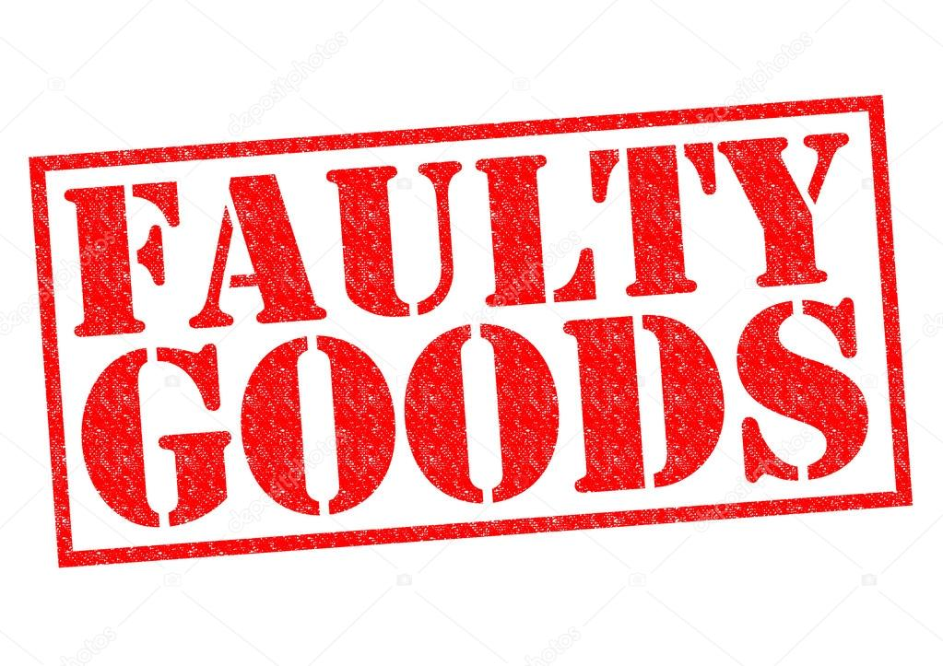

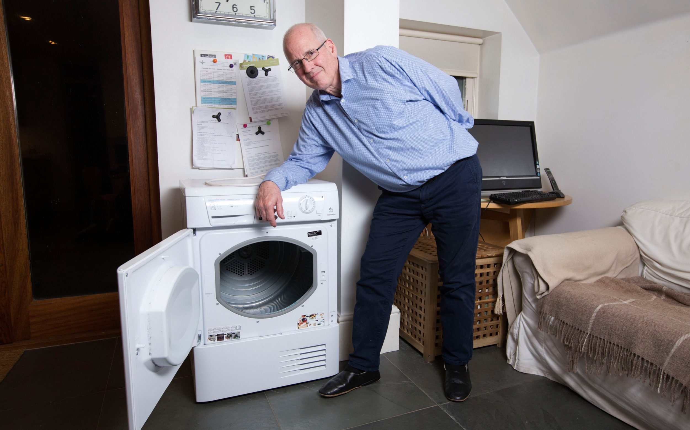
Introduction
Are the sellers liable for supplying these faulty goods?

Slide 4

Contractual liability for faulty goods in Ghana
Section 13 of the Sale of Goods Act 1962
S1
(a) ‘There is an implied condition that the goods are free from defects which are not declared or known to the buyer before or at the time when the contract is made’
(b) implied condition of reasonable fitness of goods
Arguably a broader interpretation should cover all aspects of defects that would lead a reasonable person to regard the goods as not being free from defects.

Slide 5
Contractual liability for faulty goods in Ghana
Section 13 of the Sale of Goods Act 1962
Unfortunately, our courts opted for a restrictive construction by confining the provision to latent defects.
Continental Plastics Engineering Co Ltd v IMC Industries-Technik GMBH [2009] SCGLR 298; Georgia Hotel Ltd v Silver Star [2012] 2 SCGLR, p1283.; G. A. Sarpong v Silver Star Auto Ltd [2013-2014] 2 SCGLR;
Primary focus – latent defects
Exclude appearance of the goods, reliability etc (G. A. Sarpong v Silver Star Auto Ltd [2013-2014] 2 SCGLR).
Reduces the importance of s81, SGA, 1962 on quality
Instead of judicial activism to advance consumer-oriented goals – we rather see judicial restraint in full play.

Slide 6

Contractual liability for faulty goods in the UK
9 Goods to be of satisfactory quality
(1) Every contract to supply goods is to be treated as including a term that the quality of the goods is satisfactory.
(2) The quality of goods is satisfactory if they meet the standard that a reasonable person would consider satisfactory, taking account of—
  (a) any description of the goods,
  (b) the price or other consideration for the goods (if relevant), and
  (c) all the other relevant circumstances (see subsection (5)).

Slide 7
Contractual liability for faulty goods in the UK
9 Goods to be of satisfactory quality
(3) The quality of goods includes their state and condition; and the following aspects (among others) are in appropriate cases aspects of the quality of goods—
  (a) fitness for all the purposes for which goods of that kind are usually supplied;
  (b) appearance and finish;
  (c) freedom from minor defects;
  (d) safety;
  (e) durability.

Slide 8

Alison Kynaston- Mainwaring v GVE London Ltd [2022]
Peebles v Rembrand Builders Merchants Ltd [2017]

Slide 9

Converges
Both regimes impose liability on sellers for the supply of faulty goods
Both covers latent defects
English law embraces aspects of quality including
Non-applicability
        Examined goods
        Disclosed defects
        Private sales

Slide 10

Divergence
Ghana law has been interpreted as excluding aspects of quality.
In contracts, UK strongly favours aspects of quality

Slide 11

Lessons
Aspects of quality in appropriate circumstances as exist under the UK law could equally enhance consumer protection in Ghana if parliament could intervene
Judicial activism

Slide 12

Thank you for listening.
Any questions?

