Slide 1
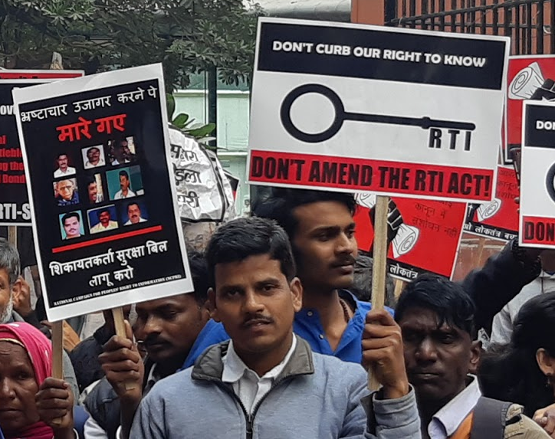
Power, compromise and the legitimisation of rule
Notes on India’s right to information movement
VIDYA VENKAT
PhD candidate, SOAS, University of London

Slide 2
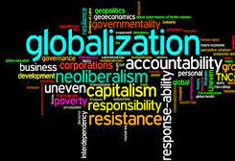
Beyond the neoliberal discourse

Slide 3
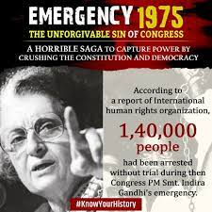
Right to Information in India
In 2005, the RTI Act was passed by the Congress-led coalition government (United Progressive Alliance or UPA)
However, the struggle for the law emerged in the late 1980s.
The demand for the law was rooted in the idea of contestation of state power
Emergence of non-party political movements to counter state abuse of power and enable democratisation in the post-Emergency era.

Slide 4
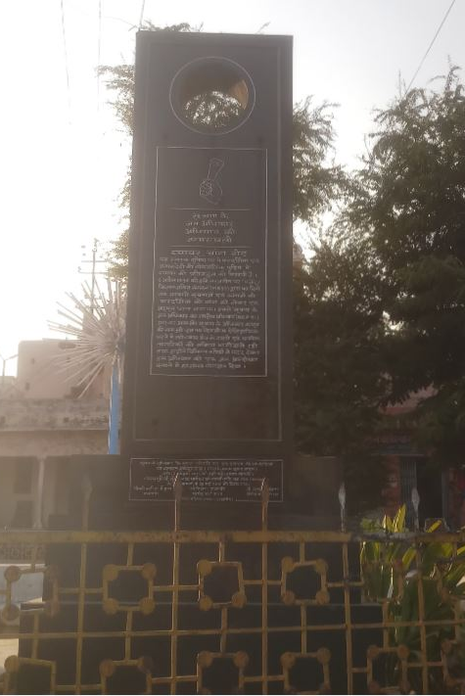
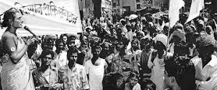
Grassroots struggle for right to information in Rajasthan

Slide 5
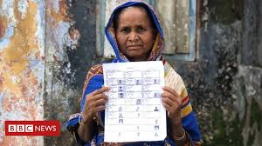
Citizen-state relations; anti-corruption discourse
Citizen-state relations have a performative aspect.
Similarly, state agencies uphold power over citizens through symbolic means. Writing, state seal etc. forms of authority.
Theories of James Scott; domination-resistance paradigm.
Hidden transcript of power.
Backstage discourses reveal critical faculties of citizens. Anti-corruption discourse a perfect example of critical engagement with the state.

Slide 6
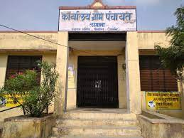
Ethnographic insights – Case study 1
In Kanthapura* gram panchayat, example of right to information activism that was used to mobilise local support to challenge political corruption.
Citizens used the Rajasthan government’s Jan Soochna Portal (public information portal) set up to enable proactive disclosures under Section 4 of RTI Act, 2005 to gain access to info on village administration expenditures on public welfare programmes.
Political rivalry and convergence of citizen groups shows emergence of a coalition of interests. Unseat “corrupt” sarpanch and elect another to replace him.

Slide 7
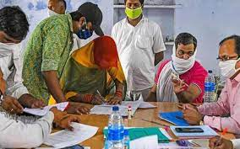
Ethnographic insights – continued…
In Kanthapura* the conclusive evidence to prove corruption actually took place couldn’t be obtained under RTI Act. But what the anti-corruption “wave” accomplished was the removal from power of the previous sarpanch who wasn’t well liked.
The new sarpanch did not press charges of corruption against the previous sarpanch because the emphasis was on completing pending public works and a compromise of sorts was reached between the two rival parties.
Jonathan Spencer’s idea of the carnivals of division prior to an election cycle is useful to understand the phenomenon.

Slide 8
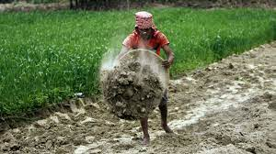
Ethnographic insights – Case study 2
In Tila* gram panchayat, another example of right to information activism where there was misappropriation of funds under the national rural employment guarantee programme
Ahead of the panchayat elections Laaloo* a local entrepreneur files RTI appeal to inspect MNREGA work records.
Allegation of corruption verified during field research. It helped Thakur’s wife capture power during elections.

Slide 9
Ethnographic insights – continued…
In this case too, one witnesses the nature of compromise worked out among the various groups. Though farmers in whose name MNREGA funds were siphoned off were aware of the misappropriation of public money, not everyone wanted to come forward to expose the corruption.
Even labourers who were falsely shown to have worked under the scheme, refused to come forward to talk about corruption for fear that they may not receive future work offers under MNREGA. Another example of compromise.
In spite of an ongoing investigation in the case, the former sarpanch enjoys the collusion of local police, bureaucrats and labourers which ensures that corruption goes unchecked. Subversion of the intent of the law.

Slide 10
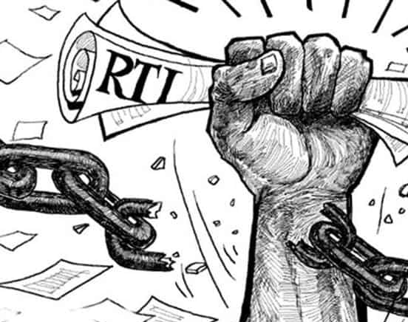
Conclusion
Government passed the RTI Act to legitimize its rule. Commitment to the idea of state transparency and accountability is a symbolic gesture to secure right to rule.
Civil society asserted power by mobilizing citizens in favour of law.
Citizens asserting power by using the law to contest state power. But success only if strong coalition of interest exists. Timing matters, such as ahead of election cycle.

